Slide 1
STUDENT INFORMATION MANAGEMENT

Slide 2
INTRODUCTION
STUDENT INFORMTION MANAGEMENT IS A NEW SYSTEM USED TO STORE THE PORTFOLIO OF STUDENT’S IN THE SCHOOL.
THIS SOFTWARE USES FILE HANDLING TO STORE THE DATA.
THIS SOFTWARE STORE,UPDATE,DELETE AND SEARCH DATA FROM FILE AND HENCE SUPPORT USER FRIENDL ENVOIRMENT.

Slide 3
HEADER FILE’S USED
#include<iostream>
#include<string.h>
#include<conio.h>
#include<fstream>
#include<stdlib.h>
#include<iomanip>
#include<windows.h>
#include<time.h>

Slide 4
DATA FILE’S USED
student.dat
Temp.dat

Slide 5
FUNCTION’S USED
VOID READDATA()
VOID ADD()
VOID DISPLAY()
VOID DELETE()
VOID SEARCH_ADMNNO()
VOID SEARCH_NAME()
VOID SEARCH_CLASS()
VOID UPDATE()
VOID ABOUT US()

Slide 6
MODULES OF PROGRAM
TO CREATE STUDENTS RECORD
TO DISPLAY STUDENTS RECORD
TO SEARCH STUDENTS RECORD
TO UPDATE STUDENTS RECORD
TO DELETE STUDENTS RECORD
ABOUT US
TO EXIT FROM MODULE

Slide 7
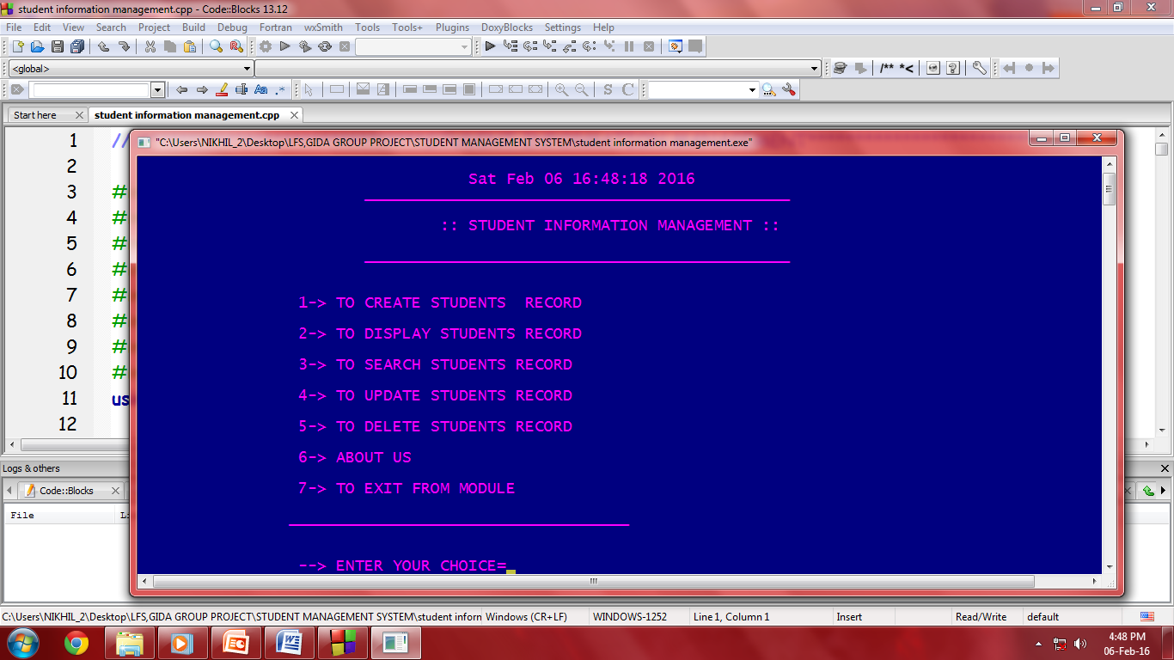
WELCOME SCREEN

Slide 8
MODULES SNAPSHOTS

Slide 9
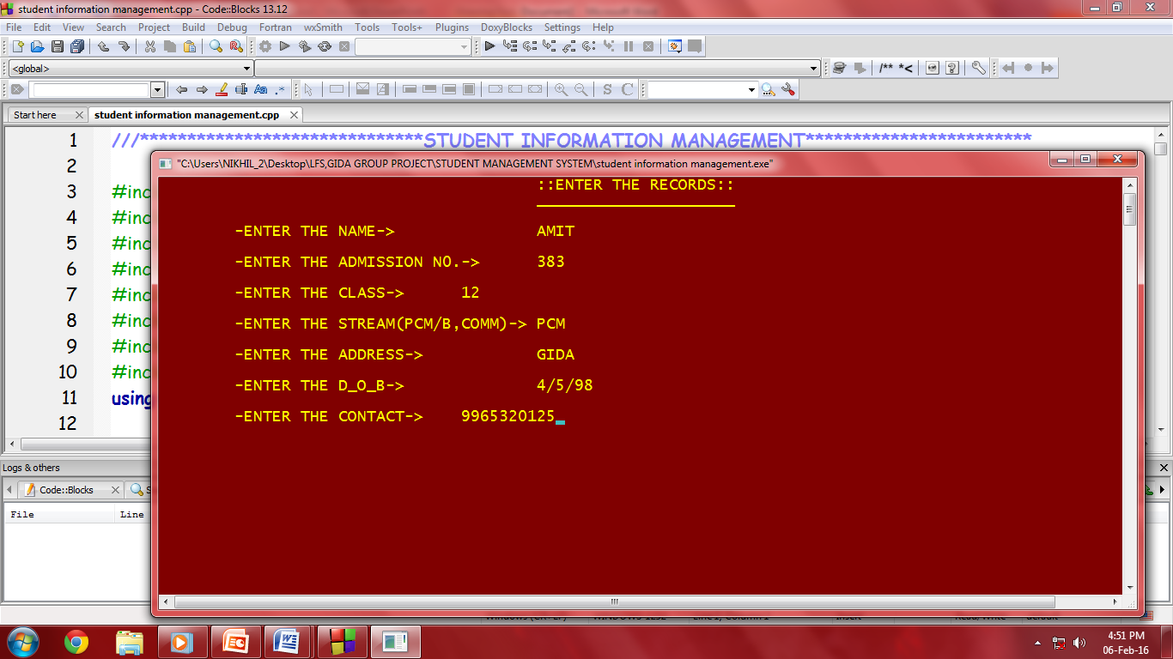
CREATE STUDENTS RECORD

Slide 10
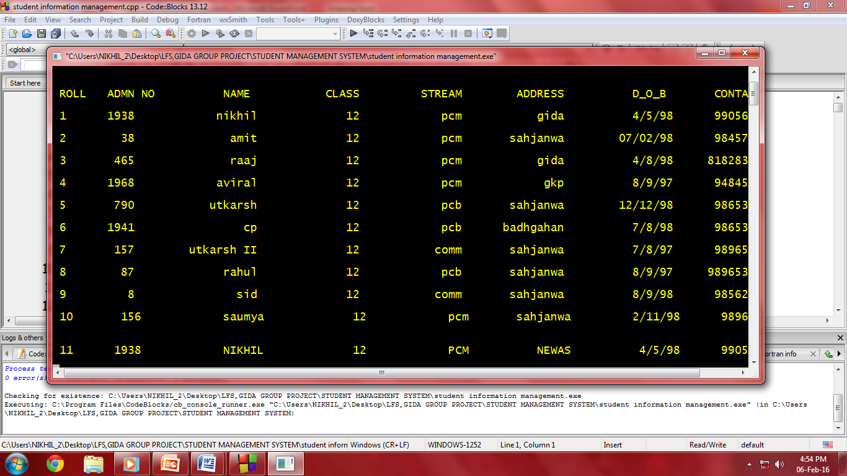
DISPLAY STUDENTS RECORD

Slide 11
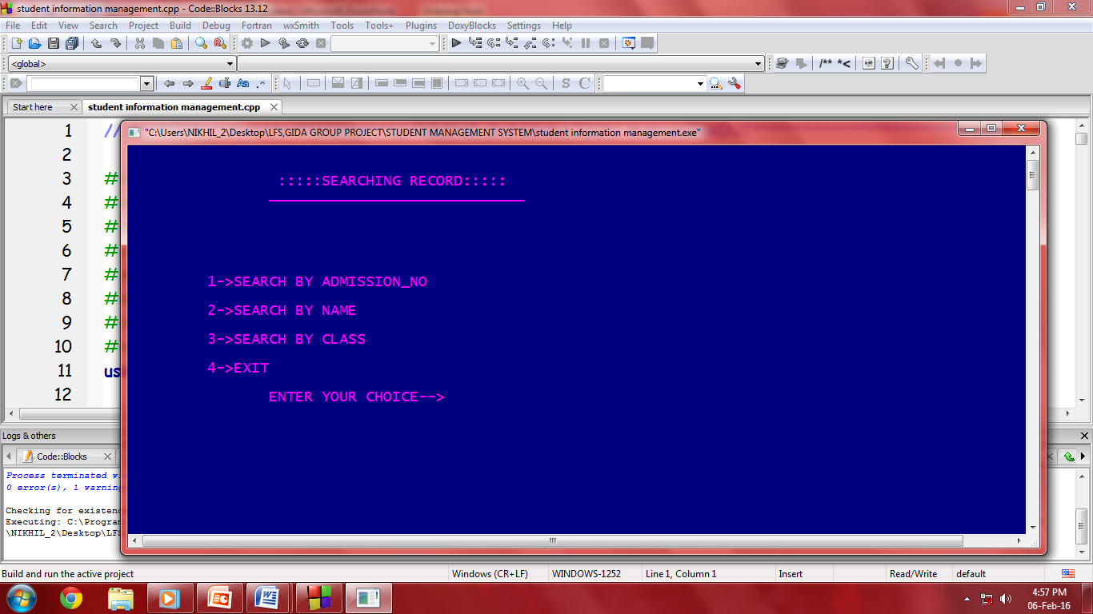
SEARCH STUDENTS RECORD

Slide 12
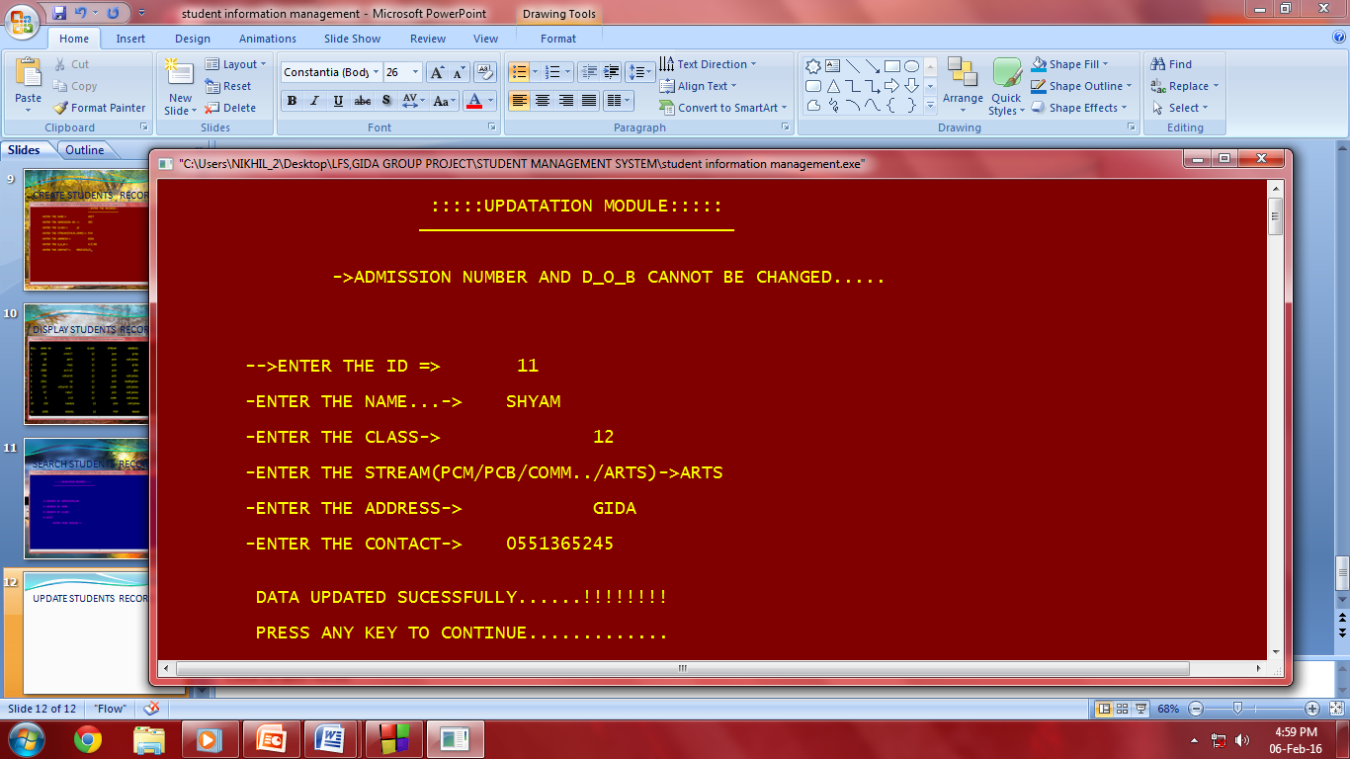
UPDATE STUDENTS RECORD

Slide 13
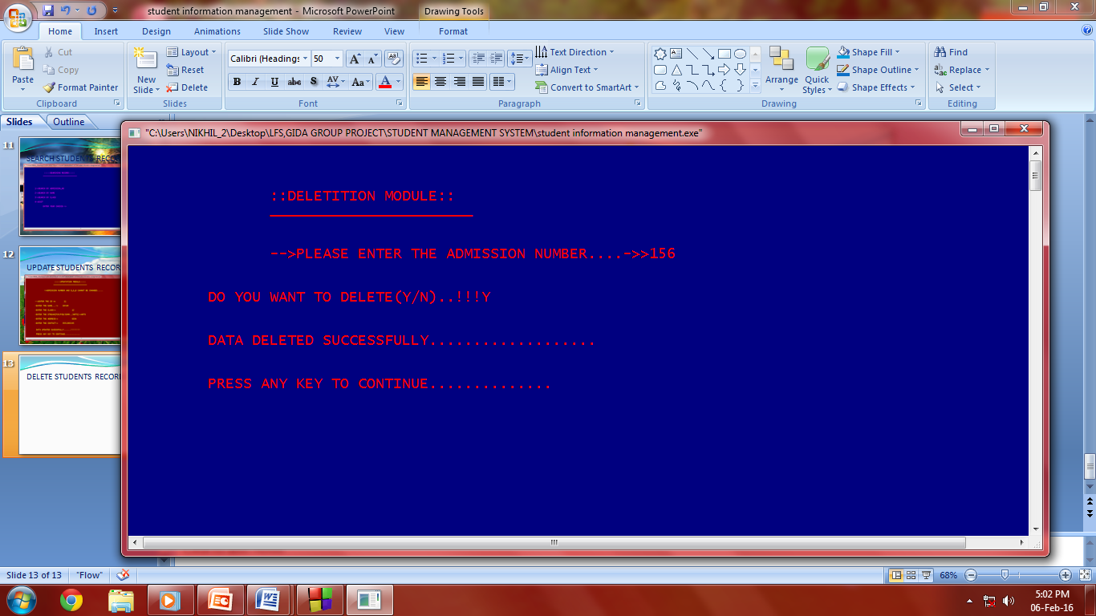
DELETE STUDENTS RECORD

Slide 14
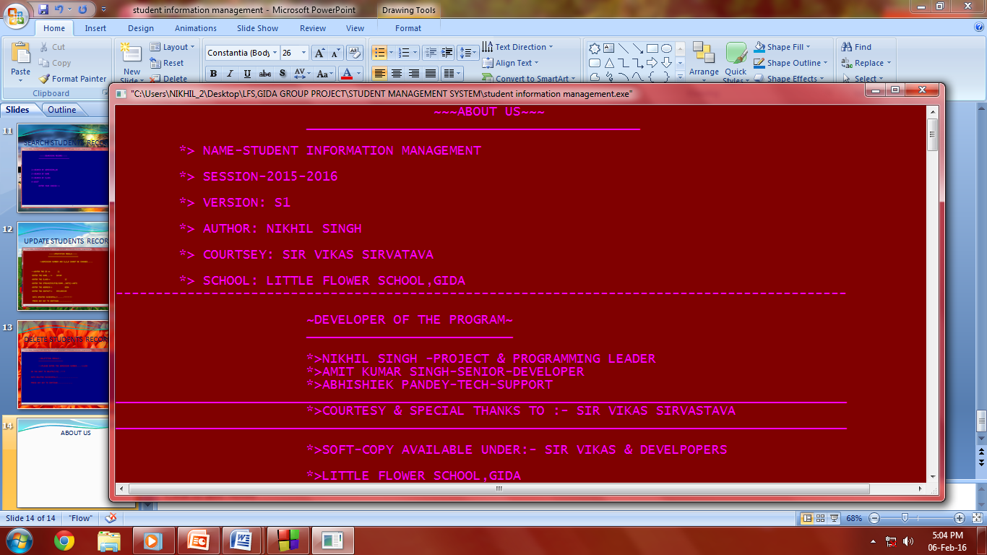
ABOUT US

